Slide 1
Product Analysis using Data science
Case study
Present by- arnab, Maitry , Dnyanesh

Slide 2
Table of content
Introduction
Data cleaning
Data Analysis
Insight and Solution

Slide 3
Introduction
In this presentation we will analyse how a business performed from the sales data
We will also try to find out what factors played a part to determine the sales

Slide 4
Data cleaning
There were 187 rows of data present
Some categorical data of same type were using different representation ( Male/M or Female/F). We converted it into only M/F.
When we tried to find the outliers it was found that most of the outliers were present in TM798. so we could not remove the outliers as it will affect the data set.
Some data were missing in the Sheet
We calculated group wise average of each product and then replaced the missing values with average.
value with the helps of other equivalent da

Slide 5
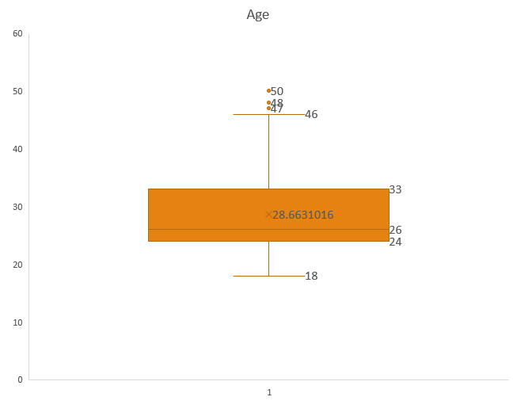
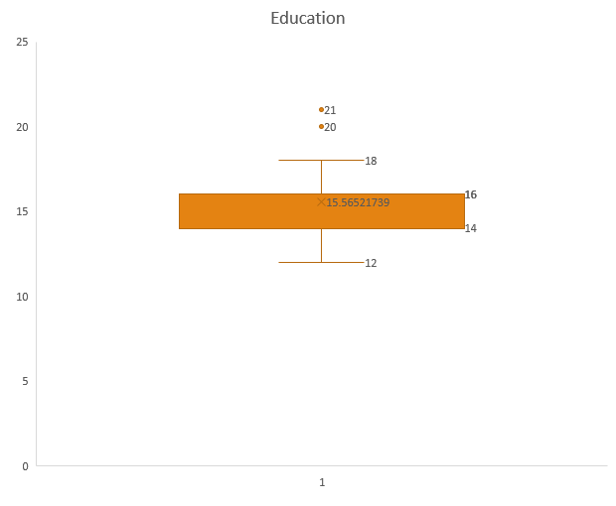

Slide 6
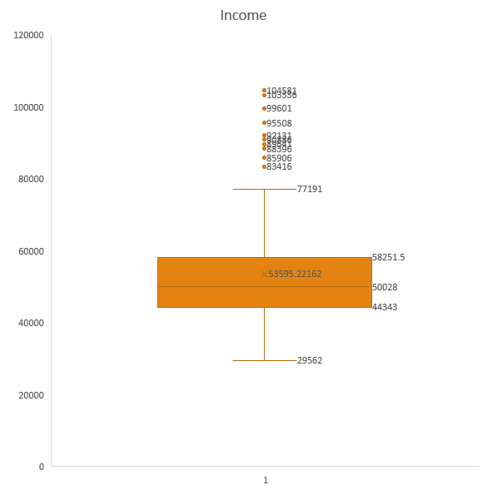
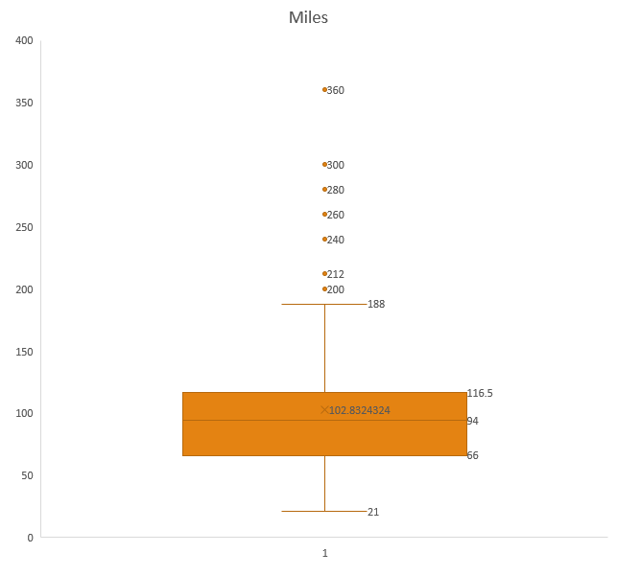

Slide 7
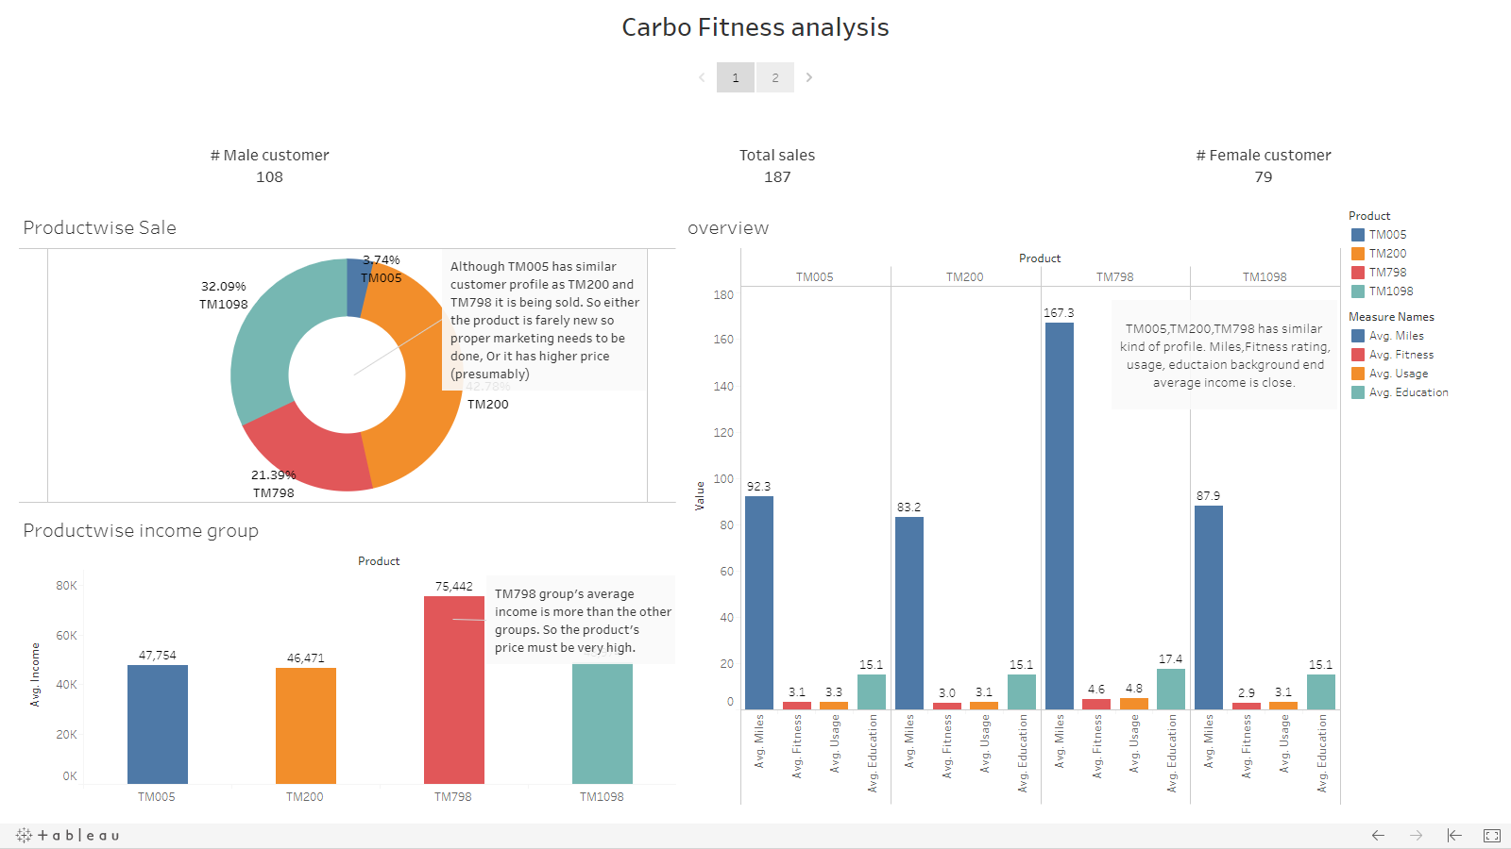

Slide 8
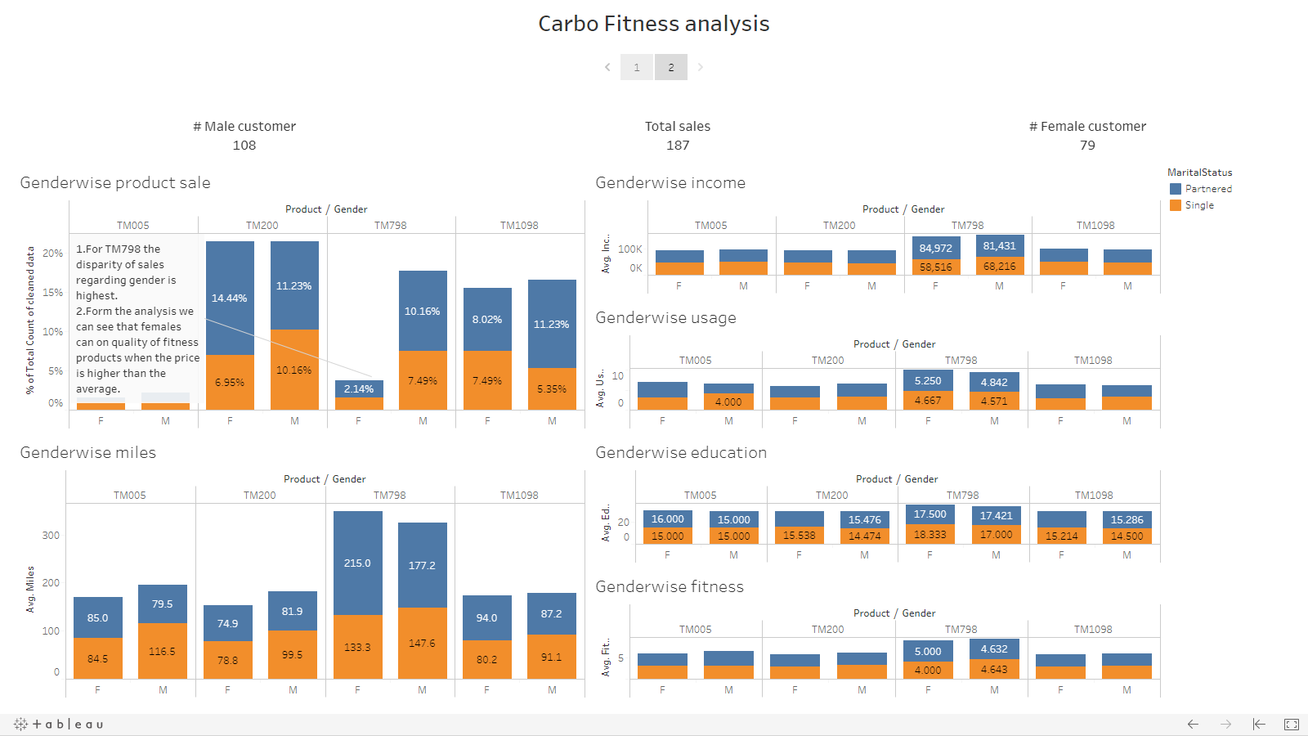

Slide 9
Data Analysis
After the Analysis we found that
TM798 – As the customers average income is higher than other groups so the product is most likely costly.
TM200 – Product quality is Average But sale is more than others
TM005 – Product’s quality is almost same of TM200 & TM1098 but sale is lower.
TM1098 – It’s Sale is average but it’s quality is lower than TM005
Tableau link - https://public.tableau.com/profile/arnab.ray.chaudhuri#!/vizhome/CarboFitnessanalysis/Story1?publish=yes
value with the helps of other equivalent da

Slide 10
Insight and Solution
Why TM005 sale is low & where Quality is average?
We need to properly market the product and if the price is higher than TM200 and TM 1098 we need to reduce that.
Why the sale is average of TM798?
Quality good but price is higher than others, so profit margin needs to be reduced
Why TM200 is more than others?
Quality average but the price is suitable
Why TM1098 is average sale?
Quality & Maybe Price is Average

Slide 11
Thank you !

